Slide 1

Introducing NativeScript
An open-source framework for building truly native mobile apps with JavaScript, TypeScript, Angular, or Vue

Slide 2
NativeScript is…

Slide 3
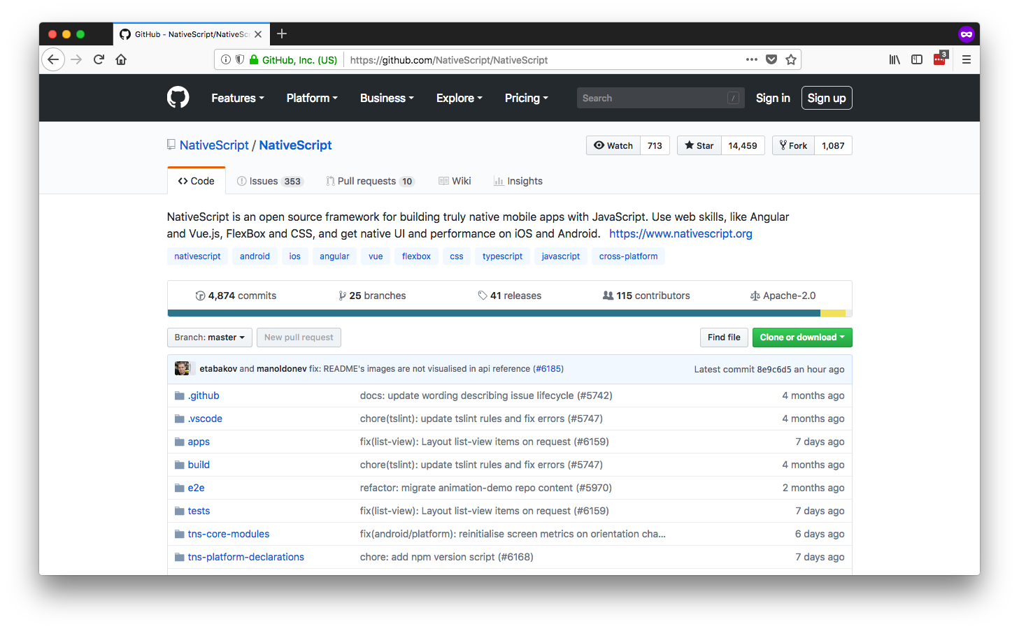
Open Source

Slide 4
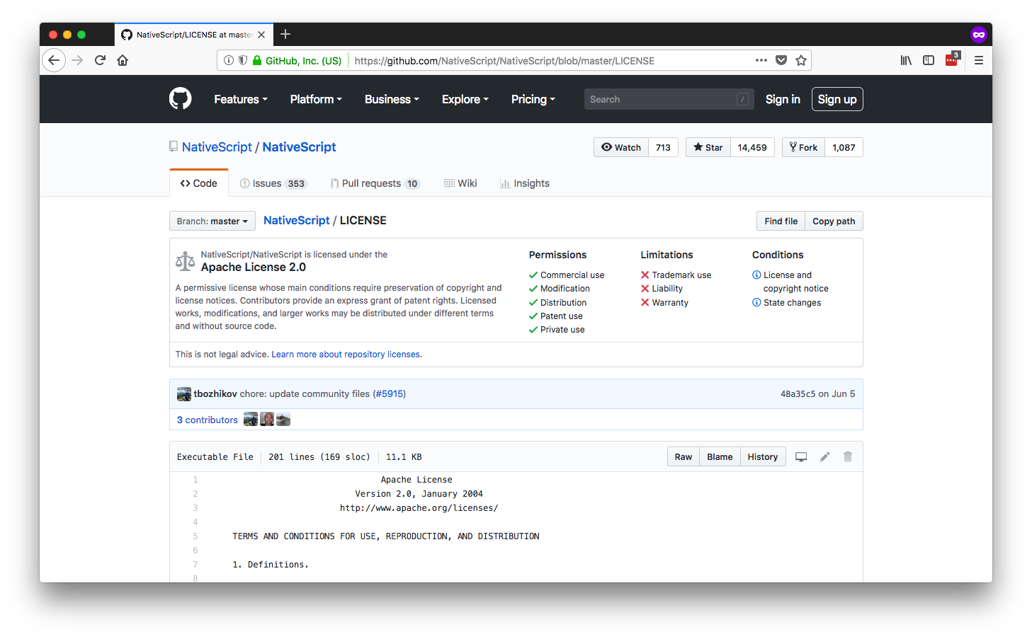
Free to Use

Slide 5
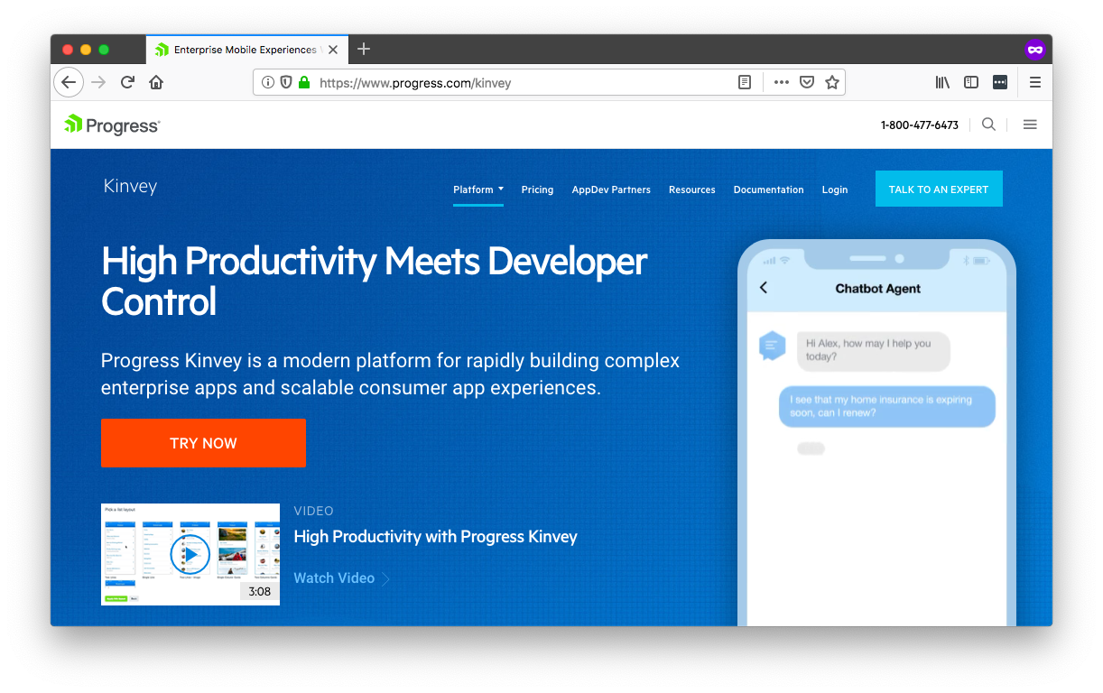
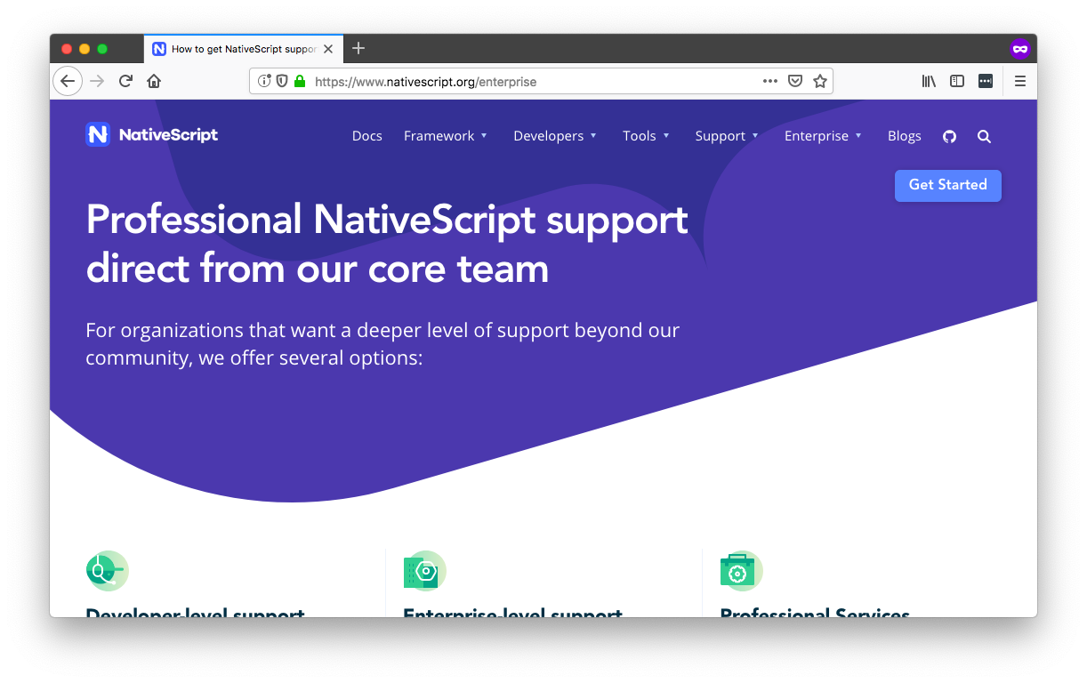
Supported by
progress.com/kinvey
nativescript.org/enterprise

Slide 6

Native & Fast

Slide 7

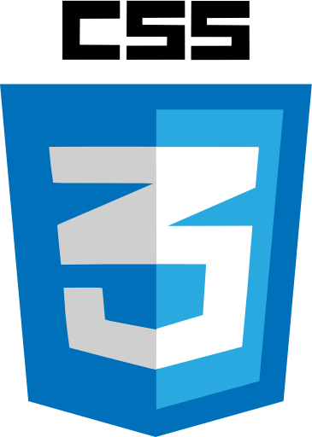




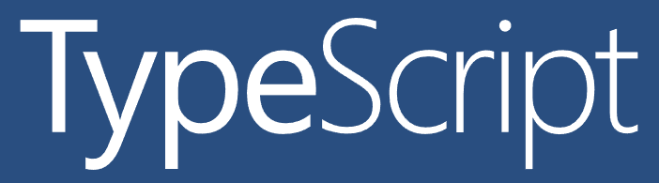

Familiar

Slide 8
Architecture Choices
or
or
or

Slide 9




!=
No DOM
Native UIs
!=
!=
JavaScript vs. C#
Framework choice

Slide 10
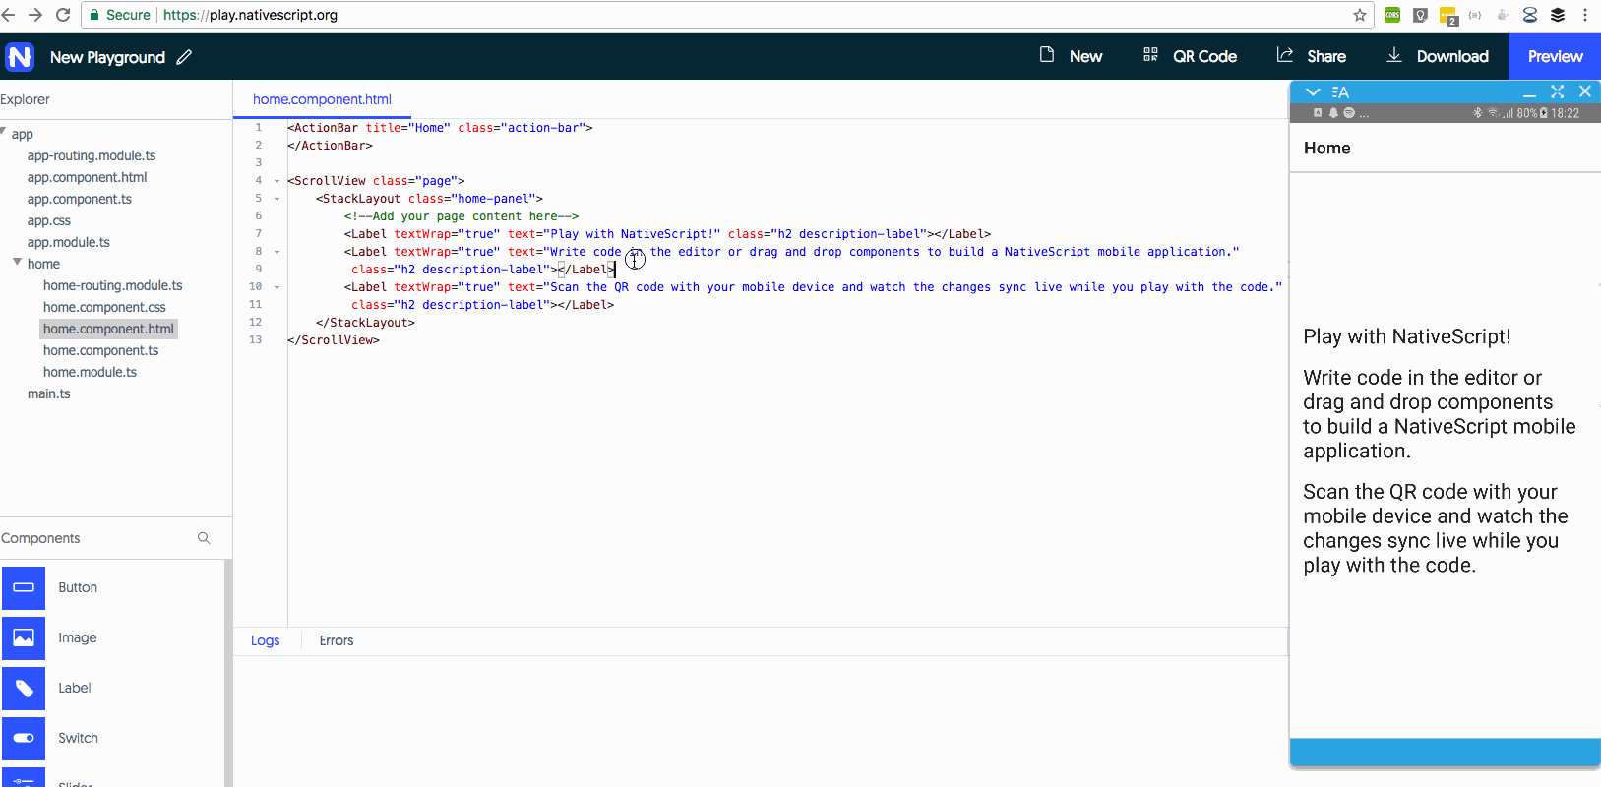
NativeScript Playground

Slide 11
Follow NativeScript!
nativescript.org/nativescript-newsletter
twitter.com/nativescript
Notes:
Want to keep up on the latest and greatest in the NativeScript world? Sign up for the NativeScript newsletter, and follow the @NativeScript handle on Twitter.

